Slide 1
“Seventh-day Activism”
Name of Church
Presenter’s Name

Slide 2
The best help that ministers can give the members of our churches is not sermonizing,

Slide 3
The best help that ministers can give the members of our churches is not sermonizing, but planning work for them. Give each one something to do for others. . . . And let all be taught how to work. R&H Jan. 21, 1902

Slide 6
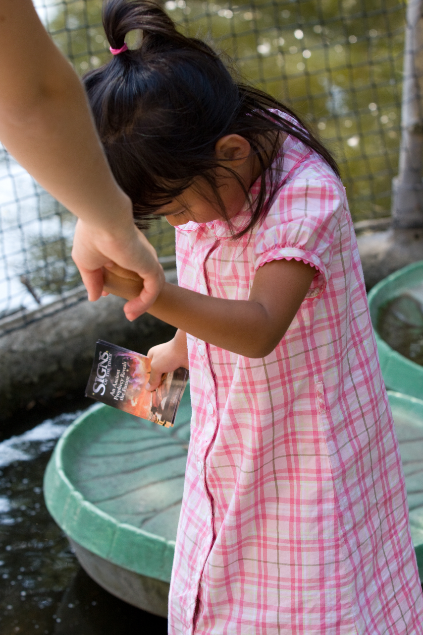

Slide 7
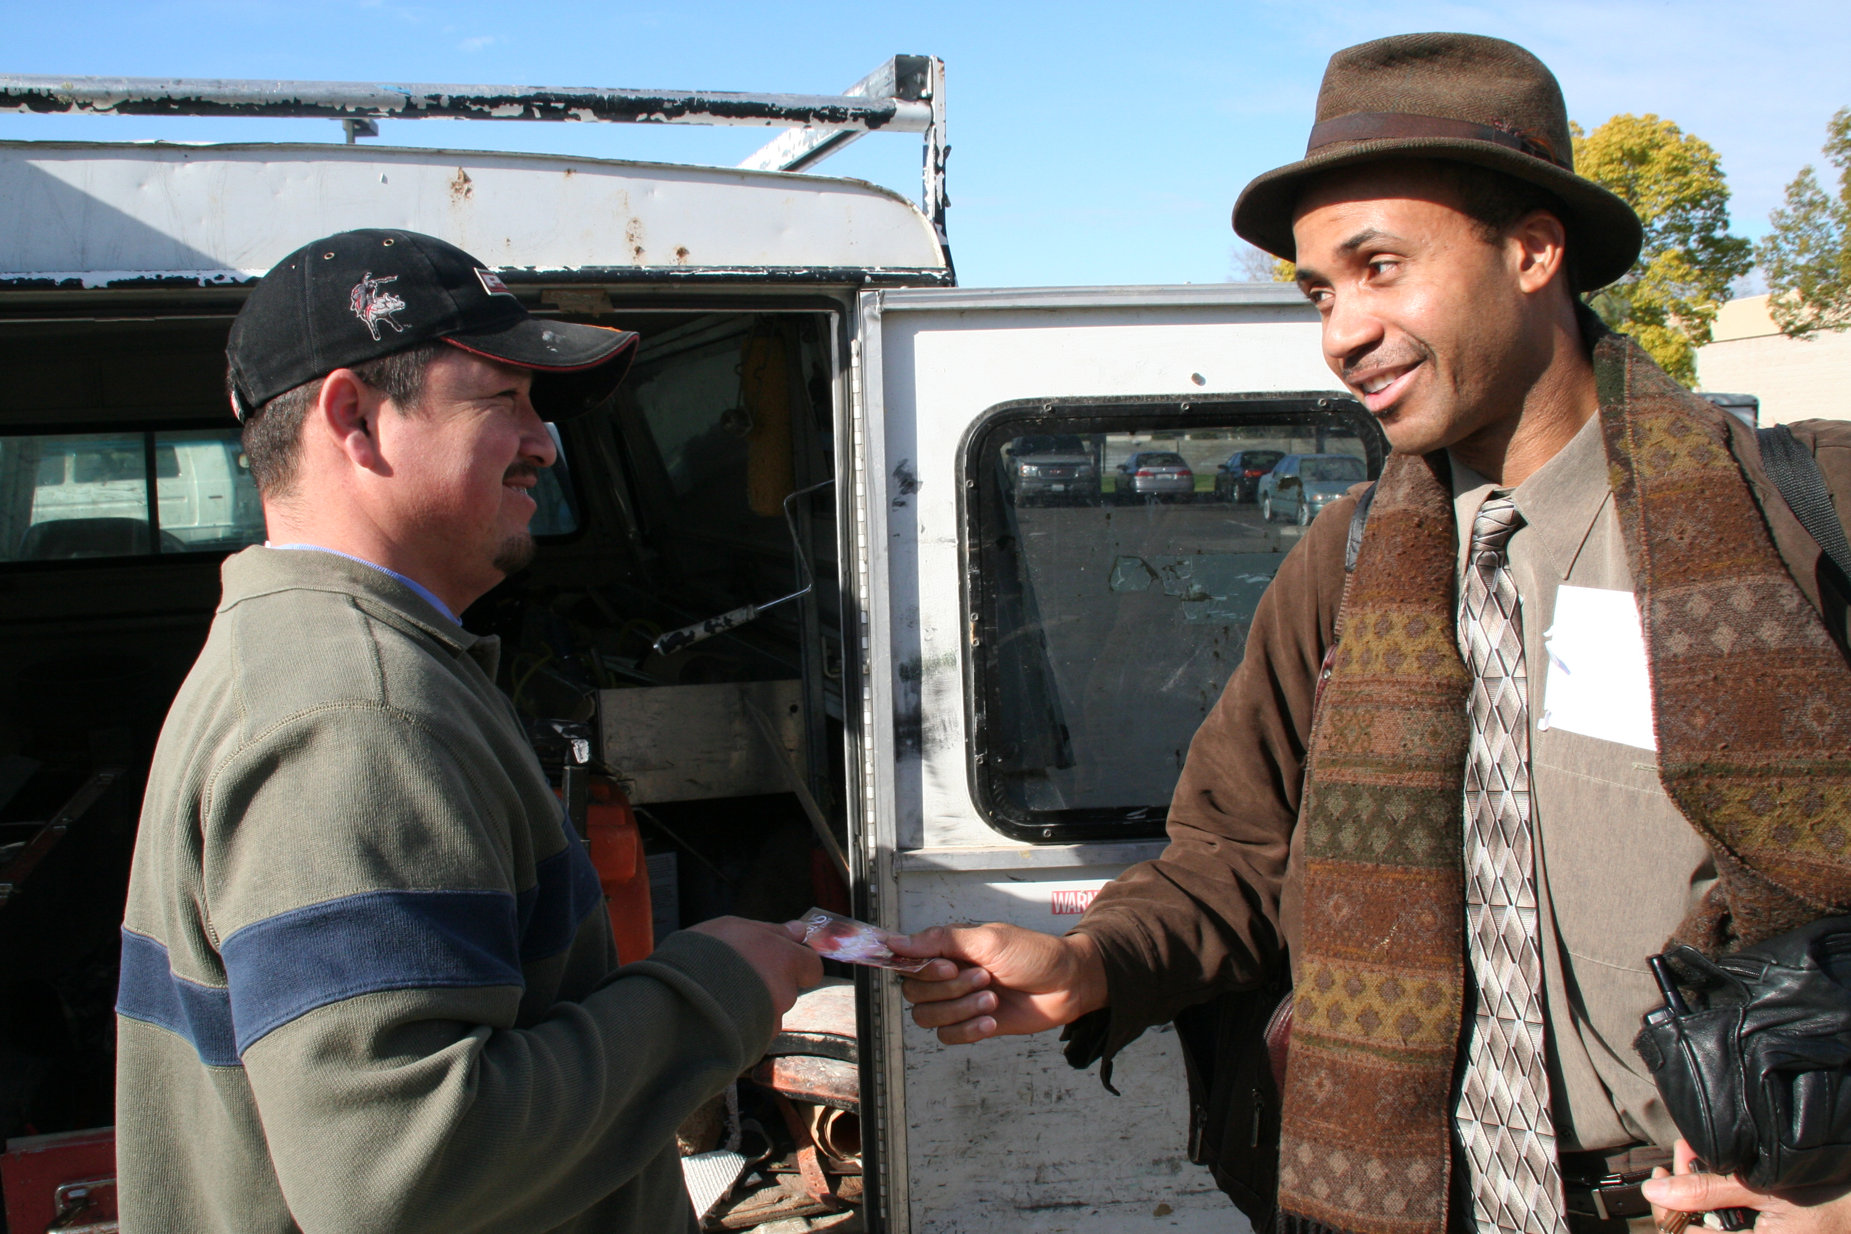

Slide 8
How to GLOW
While on Weekly Errands – In grocery lines, at Wal-Mart, etc.

Slide 9
How to GLOW
While on Weekly Errands– In grocery lines, at Wal-Mart, etc.
Wal-Mart Shopping Cart

Slide 10
How to GLOW
While on Weekly Errands– In grocery lines, at Wal-Mart, etc.
Sabbath Shopping Cart
Gas Stations – Leave literature on gas pumps & bathrooms.

Slide 11
How to GLOW
While on Weekly Errands– In grocery lines, at Wal-Mart, etc.
Sabbath Shopping Cart
Gas Stations – Leave literature on gas pumps & bathrooms.
Restaurants – Leave literature with your tip.

Slide 12
How to GLOW
While on Weekly Errands– In grocery lines, at Wal-Mart, etc.
Sabbath Shopping Cart
Gas Stations – Leave literature on gas pumps & bathrooms.
Restaurants – Leave literature with your tip.
Spaghetti Factory

Slide 13
How to GLOW
While on Weekly Errands– In grocery lines, at Wal-Mart, etc.
Sabbath Shopping Cart
Gas Stations – Leave literature on gas pumps & bathrooms.
Restaurants – Leave literature with your tip.
Spaghetti Factory
Michigan McDonalds

Slide 14
How to GLOW
While on Weekly Errands– In grocery lines, at Wal-Mart, etc.
Sabbath Shopping Cart
Gas Stations – Leave literature on gas pumps & bathrooms.
Restaurants – Leave literature with your tip.
Spaghetti Factory
Michigan Baptist Pastor
Bill Payments – Send literature through the mail.

Slide 15
How to GLOW
While on Weekly Errands– In grocery lines, at Wal-Mart, etc.
Sabbath Shopping Cart
Gas Stations – Leave literature on gas pumps & bathrooms.
Restaurants – Leave literature with your tip.
Spaghetti Factory
Michigan Baptist Pastor
Bill Payments – Send literature through the mail.
Photocopied SOD

Slide 16
How to GLOW
While on Weekly Errands– In grocery lines, at Wal-Mart, etc.
Sabbath Shopping Cart
Gas Stations – Leave literature on gas pumps & bathrooms.
Restaurants – Leave literature with your tip.
Spaghetti Factory
Michigan Baptist Pastor
Bill Payments – Send literature through the mail.
Photocopied SOD
Desk Holder – Give it to everyone you work with.

Slide 17
How to GLOW
While on Weekly Errands– In grocery lines, at Wal-Mart, etc.
Sabbath Shopping Cart
Gas Stations – Leave literature on gas pumps & bathrooms.
Restaurants – Leave literature with your tip.
Spaghetti Factory
Michigan Baptist Pastor
Bill Payments – Send literature through the mail.
Photocopied SOD
Desk Holder – Give it to everyone you work with.
Large Gatherings- (i.e. Flee Markets, Concerts, etc.)

Slide 18
How to GLOW
While on Weekly Errands– In grocery lines, at Wal-Mart, etc.
Sabbath Shopping Cart
Gas Stations – Leave literature on gas pumps & bathrooms.
Restaurants – Leave literature with your tip.
Spaghetti Factory
Michigan Baptist Pastor
Bill Payments – Send literature through the mail.
Photocopied SOD
Desk Holder – Give it to everyone you work with.
Large Gatherings- (i.e. Flee Markets, Concerts, etc.)
Rosebowl Parade

Slide 19
How to GLOW
While on Weekly Errands– In grocery lines, at Wal-Mart, etc.
Sabbath Shopping Cart
Gas Stations – Leave literature on gas pumps & bathrooms.
Restaurants – Leave literature with your tip.
Spaghetti Factory
Michigan Baptist Pastor
Bill Payments – Send literature through the mail.
Photocopied SOD
Desk Holder – Give it to everyone you work with.
Large Gatherings- (i.e. Flee Market, Concerts, etc.)
Rosebowl Parade
On a Table – In a public place for others to see.

Slide 20
How to GLOW
While on Weekly Errands– In grocery lines, at Wal-Mart, etc.
Sabbath Shopping Cart
Gas Stations – Leave literature on gas pumps & bathrooms.
Restaurants – Leave literature with your tip.
Spaghetti Factory
Bill Payments – Send literature through the mail.
Photocopied SOD
Desk Holder – Give it to everyone you work with.
Large Gatherings- (i.e. Flee Markets, Concerts, etc.)
Rosebowl Parade
On a Table – In a public place for others to see.
Merced County Jail

Slide 21
How to GLOW
Laundromats – Leave/restock literature every 1 or 2 weeks

Slide 22
How to GLOW
Laundromats – Leave/restock literature every 1 or 2 weeks
Hotel Rooms – Use as Gideon Bible bookmarks

Slide 23
How to GLOW
Laundromats – Leave/restock literature every 1 or 2 weeks
Hotel Rooms – Use as Gideon Bible bookmarks
Halloween Giveaways – Give to Trick or Treaters

Slide 24
How to GLOW
Laundromats – Leave/restock literature every 1 or 2 weeks
Hotel Rooms – Use as Gideon Bible bookmarks
Halloween Giveaways – Give to Trick or Treaters
Pathfinders

Slide 25
How to GLOW
Laundromats – Leave/restock literature every 1 or 2 weeks
Hotel Rooms – Use as Gideon Bible bookmarks
Halloween Giveaways – Give to Trick or Treaters
Pathfinders
Cashiers at Stores

Slide 26
How to GLOW
Laundromats – Leave/restock literature every 1 or 2 weeks
Hotel Rooms – Use as Gideon Bible bookmarks
Halloween Giveaways – Give to Trick or Treaters
Pathfinders
Cashiers at Stores
Taco Bell Drive Through

Slide 27
GLOW Mindset
How to get in the Habit of Distributing Literature
Choose one location in your house and in your car.
Pray during your devotional time for divine appointments. This helps you meet the right people at the right time with the right literature and it helps get you into the mindset of distribution. (Fresno Court) (AZ Bus) (Templeton Joseph)

Slide 28
The Home Bible Study Plan- How it Works
-They call, write, or e-mail
-Church gets the contact info.
-Correspondence → Amazing Facts

Slide 29
“More than one thousand will soon be converted in one day, most of whom will trace their first convictions to the reading of our publications.”
--Review and Herald, Nov. 10, 1885.

